Slide 1


Amazon Branch Sales Analytics

Slide 2
Business Problem
Amazon, a global e-commerce giant, operates numerous branches across various geographical regions. Currently the sales and customer satisfaction is not up to the mark in Amazon's branches across Mandalay, Yangon, and Naypyitaw, Myanmar.

Slide 3
Business Objective
The business objective is to identify key drivers and regional market dynamics and optimize sales performance and customer satisfaction across Amazon's branches in Myanmar

Slide 4
Project objective
The objective of this project is to analyze the sales data of Amazon's branches to gain insights into branch sales trends, customer behavior, and factors influencing sales performance and provide actionable recommendations for optimizing sales and customer satisfaction.

Slide 5
Project Architecture
Business Understanding
Data Understanding
Data Collection
Data Insights
Data Wrangling
Exploratory Data Analysis

Slide 6
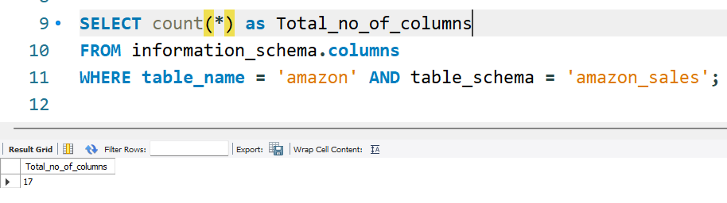
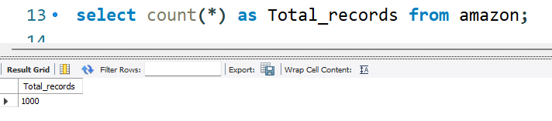
Data Understanding
The list of columns present in the dataset are: 'Invoice ID', 'Branch', 'City', 'Customer type', 'Gender','Product line', 'Unit price', 'Quantity', 'Tax 5%', 'Total', 'Date','Time', 'Payment', 'cogs', 'gross margin percentage', 'gross income',’Rating’ .
Shape of the dataset is 1000 rows and 17 columns.

Slide 7

Data Understanding
The list of categorical columns present in the dataset are:
Branch : A,B,C
City : Mandalay, Yangon, and Naypyitaw
Customer type : Normal, Member
Gender : Female, Male
Product line : Health and beauty, Electronic accessories, Home and lifestyle,
Sports and travel, Food and beverages, Fashion accessories
Payment : E-wallet, Cash, Credit Card
Rating : 1-10

Slide 8
Feature engineering
Created three extra columns from Time and Date
Timeofday ----- Morning, Afternoon and Evening
MonthName— Jan,Feb,March etc.
DayName ------ Mon, Tue, wed etc.
Need to add One more column named Product_line_Quality to check product line is Good or Bad based on Average of cogs.

Slide 9
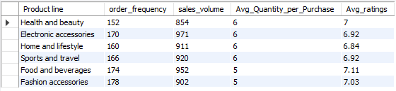
Product Analysis
Order Frequency: Fashion accessories(178) have the highest order frequency, indicating strong demand for these products as compared to other product lines. The least selling product and the least Quantity ordered for Health and beauty.
Sales Volume: Electronic Accessories(971) products have the highest sales volume, suggesting potentially higher-priced items or larger quantities being sold in this category.

Slide 10
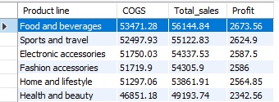
Product Analysis: Sales Volume, Order Count, Revenue, Avg_Ratings
Profit and Total Revenue : Food and beverages have highest Total_sales($56144.84) and profitability(2673.56) followed by sports and travel, and electronic accessories are the most profitable product lines, generating the highest profits compared to others.
Cost of Goods Sold (COGS): Although food and beverages have the highest total sales followed by sports and travel and electronic accessories have higher COGS also, indicating potentially higher production or acquisition costs in these categories.

Slide 11
Product Analysis
Product Line | Purchase Frequency | Quantity Sold | Total COGS | Total Revenue | Profit | Avg Rating
Health and beauty | 152 | 854 | 46851.18 | 49194 | 2342.56 | 7
Home and lifestyle | 160 | 911 | 51297.06 | 53862 | 2564.85 | 6.84
Sports and travel | 166 | 920 | 52497.93 | 55123 | 2624.9 | 6.92
Electronic accessories | 170 | 971 | 51750.03 | 54338 | 2587.5 | 6.92
Food and beverages | 174 | 952 | 53471.28 | 56145 | 2673.56 | 7.11
Fashion accessories | 178 | 902 | 51719.9 | 54306 | 2586 | 7.03

Slide 12

Product analysis Per Branch
Naypyitaw's Branch C showcasing highest sales(110569) despite of having lowest Purchase_frequency(328).
Yangon’s Branch A sold maximum number of items.
Mandalay’s Branch lowest total sales(106198).

Slide 13
City | Branch | Product Line | PurchaseFreq. | Total_COGS | Quantity | Revenue | Profit | Avg_Rating
 |  | Health and beauty | 47 | 11997.86 | 257 | 12598 | 599.89 | 6.9
 |  | Fashion accessories | 51 | 15554.77 | 263 | 16333 | 777.74 | 6.88
Yangon | A | Food and beverages | 58 | 16345.81 | 313 | 17163 | 817.29 | 7.25
 |  | Sports and travel | 59 | 18450.19 | 333 | 19373 | 922.51 | 7.26
 |  | Electronic accessories | 60 | 17444.87 | 322 | 18317 | 872.24 | 6.91
 |  | Home and lifestyle | 65 | 21349.71 | 371 | 22417 | 1067.49 | 6.93
 |  | Home and lifestyle | 50 | 16713.49 | 295 | 17549 | 835.67 | 6.52
 |  | Food and beverages | 50 | 14490.37 | 270 | 15215 | 724.52 | 6.99
Mandalay | B | Health and beauty | 53 | 19029.2 | 320 | 19981 | 951.46 | 7.1
 |  | Electronic accessories | 55 | 16239.47 | 316 | 17051 | 811.97 | 7.12
 |  | Sports and travel | 62 | 19036.38 | 322 | 19988 | 951.82 | 6.51
 |  | Fashion accessories | 62 | 15631.73 | 297 | 16413 | 781.59 | 6.72
 |  | Sports and travel | 45 | 15011.36 | 265 | 15762 | 750.57 | 7.03
 |  | Home and lifestyle | 45 | 13233.86 | 245 | 13896 | 661.69 | 7.06
Naypyitaw | C | Health and beauty | 52 | 15824.12 | 277 | 16615 | 791.21 | 7
 |  | Electronic accessories | 55 | 18065.69 | 333 | 18969 | 903.28 | 6.75
 |  | Fashion accessories | 65 | 20533.4 | 342 | 21560 | 1026.67 | 7.44
 |  | Food and beverages | 66 | 22635.1 | 369 | 23767 | 1131.75 | 7.08

Slide 14
City | Branch | Product Line | Rank_Purchase_frequency | Rank_Total_COGS | Rank_Total_Quantity | Rank_Total_Revenue | Rank_profit | Rank_Avg_ratings
Yangon | A | Sports and travel | 3 | 2 | 2 | 2 | 2 | 1
Yangon | A | Food and beverages | 4 | 4 | 4 | 4 | 4 | 2
Yangon | A | Home and lifestyle | 1 | 1 | 1 | 1 | 1 | 3
Yangon | A | Electronic accessories | 2 | 3 | 3 | 3 | 3 | 4
Yangon | A | Health and beauty | 6 | 6 | 6 | 6 | 6 | 5
Yangon | A | Fashion accessories | 5 | 5 | 5 | 5 | 5 | 6
Mandalay | B | Electronic accessories | 3 | 4 | 3 | 4 | 4 | 1
Mandalay | B | Health and beauty | 4 | 2 | 2 | 2 | 2 | 2
Mandalay | B | Food and beverages | 5 | 6 | 6 | 6 | 6 | 3
Mandalay | B | Fashion accessories | 1 | 5 | 4 | 5 | 5 | 4
Mandalay | B | Home and lifestyle | 5 | 3 | 5 | 3 | 3 | 5
Mandalay | B | Sports and travel | 1 | 1 | 1 | 1 | 1 | 6
Naypyitaw | C | Fashion accessories | 2 | 2 | 2 | 2 | 2 | 1
Naypyitaw | C | Food and beverages | 1 | 1 | 1 | 1 | 1 | 2
Naypyitaw | C | Home and lifestyle | 5 | 6 | 6 | 6 | 6 | 3
Naypyitaw | C | Sports and travel | 5 | 5 | 5 | 5 | 5 | 4
Naypyitaw | C | Health and beauty | 4 | 4 | 4 | 4 | 4 | 5
Naypyitaw | C | Electronic accessories | 3 | 3 | 3 | 3 | 3 | 6

Slide 15
Insights From product Analysis
Consistent Leaders: "Home and lifestyle" in Yangon, "Sports and travel" in Mandalay, and "Food and beverages" in Naypyitaw are the most consistently high-performing product lines in their respective branches.
Opportunities for Improvement:
Branch A could focus on improving the performance of "Health and beauty" and "Fashion accessories".
Branch B could work on boosting "Food and beverages" and improving the Avg_ratings for "Sports and travel".
Branch C might benefit from strategies to enhance the performance of "Home and lifestyle" and "Sports and travel".
Avg_ratings Influence: Despite some product lines performing well across other parameters, their lower Avg_ratings could indicate a need for quality improvements or better customer satisfaction efforts (e.g., "Sports and travel" in Mandalay).
Potential Growth Areas: Product lines that show high potential but have room for improvement in certain areas, such as "Electronic accessories" in all branches and "Health and beauty" in Yangon and Naypyitaw, should be targeted for strategic growth initiatives.

Slide 16
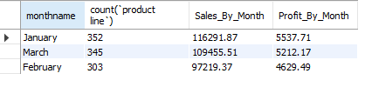
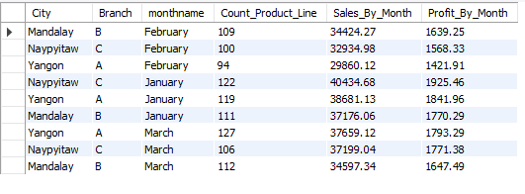
Sales Trend
The highest sales happened in the month of January.
In January , Naypyitaw contributing the highest amount,
in February Mandalay is on top
Yangon is leading in March.

Slide 17
 | Month | Product Line | Purchase_frequency | Total_COGS | Total_Quantity | Total_Revenue | profit | Avg_ratings
 | January | Electronic accessories | 54 | 17934.56 | 333 | 18831 | 896.73 | 7.14
 | January | Fashion accessories | 64 | 18423.92 | 336 | 19345 | 921.2 | 7.06
 | January | Food and beverages | 56 | 18638.6 | 325 | 19571 | 931.93 | 7.41
 | January | Health and beauty | 49 | 15603.02 | 254 | 16383 | 780.15 | 7.13
 | January | Home and lifestyle | 59 | 19518.8 | 342 | 20495 | 975.94 | 6.67
 | January | Sports and travel | 70 | 20635.26 | 375 | 21667 | 1031.76 | 6.78
 | February | Electronic accessories | 54 | 16536.1 | 313 | 17363 | 826.8 | 6.96
 | February | Fashion accessories | 60 | 18104.63 | 295 | 19010 | 905.23 | 7.08
 | February | Food and beverages | 62 | 19047.96 | 349 | 20000 | 952.4 | 7.01
 | February | Health and beauty | 46 | 13906.91 | 266 | 14602 | 695.35 | 7.21
 | February | Home and lifestyle | 38 | 11842.27 | 205 | 12434 | 592.11 | 7.07
 | February | Sports and travel | 43 | 13152.01 | 226 | 13810 | 657.6 | 7.13
 | March | Electronic accessories | 62 | 17279.37 | 325 | 18143 | 863.97 | 6.7
 | March | Fashion accessories | 54 | 15191.35 | 271 | 15951 | 759.57 | 6.93
 | March | Food and beverages | 56 | 15784.72 | 278 | 16574 | 789.24 | 6.93
 | March | Health and beauty | 57 | 17341.25 | 334 | 18208 | 867.06 | 6.73
 | March | Home and lifestyle | 63 | 19935.99 | 364 | 20933 | 996.8 | 6.85
 | March | Sports and travel | 53 | 18710.66 | 319 | 19646 | 935.53 | 6.92

Slide 18
 | Branch | Product Line | Rank_Purchase_frequency | Rank_Total_COGS | Rank_Total_Quantity | Rank_Total_Revenue | Rank_profit | Rank_Avg_ratings
 | January | Electronic accessories | 5 | 5 | 4 | 5 | 5 | 2
 | January | Fashion accessories | 2 | 4 | 3 | 4 | 4 | 4
 | January | Food and beverages | 4 | 3 | 5 | 3 | 3 | 1
 | January | Health and beauty | 6 | 6 | 6 | 6 | 6 | 3
 | January | Home and lifestyle | 3 | 2 | 2 | 2 | 2 | 6
 | January | Sports and travel | 1 | 1 | 1 | 1 | 1 | 5
 | February | Electronic accessories | 3 | 3 | 2 | 3 | 3 | 6
 | February | Fashion accessories | 2 | 2 | 3 | 2 | 2 | 3
 | February | Food and beverages | 1 | 1 | 1 | 1 | 1 | 5
 | February | Health and beauty | 4 | 4 | 4 | 4 | 4 | 1
 | February | Home and lifestyle | 6 | 6 | 6 | 6 | 6 | 4
 | February | Sports and travel | 5 | 5 | 5 | 5 | 5 | 2
 | March | Electronic accessories | 2 | 4 | 3 | 4 | 4 | 6
 | March | Fashion accessories | 5 | 6 | 6 | 6 | 6 | 1
 | March | Food and beverages | 4 | 5 | 5 | 5 | 5 | 2
 | March | Health and beauty | 3 | 3 | 2 | 3 | 3 | 5
 | March | Home and lifestyle | 1 | 1 | 1 | 1 | 1 | 4
 | March | Sports and travel | 6 | 2 | 4 | 2 | 2 | 3

Slide 19
Insights
In January Sports and Travel Generating the highest Revenue.
In February “Food and Beverages” Generating the highest Revenue.
In March “Home and Lifestyle” Generating the highest sales.
“Health and Beauty” performing least in January but showing consistent improvements in total sales.
Home and lifestyle generating highest sales in February and performing least in March.

Slide 20
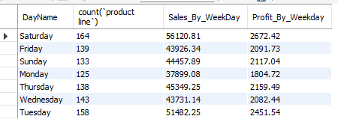
Sales Analysis by Product Line, Branch and Day_Name
The highest sales happened on Saturday’s.

Slide 21
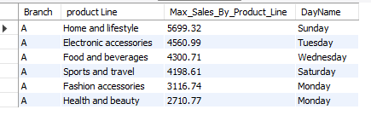
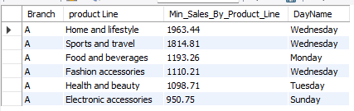
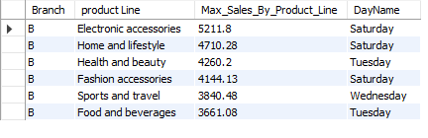
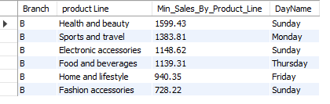
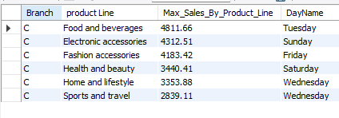
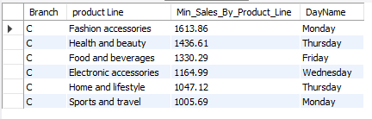
Sales Analysis by Product Line, Branch and Day_Name
Branch A
“Home and Life style” are leading on Sunday.
“Electronic Accessories” are least performing on Sunday.
Branch B
“Electronic Accessories” And “Home and beauty” leading
on Saturdays.
“Fashion Accessories” are least performing on Sunday.
Branch C
“Food and Beverages” are leading on Tuesday.
“Sport and Travel” are least performing on Monday.

Slide 22

Sales Analysis by Day_Time
Highest sales happened during Afternoon times.

Slide 23
Sales Analysis by Product Line and Day_Time
Product Line | Day Time | Count | Sales | Profit
Electronic accessories | Afternoon | 83 | 26348.53 | 1254.69
Electronic accessories | Evening | 52 | 17821.05 | 848.62
Electronic accessories | Morning | 35 | 10167.95 | 484.19
Fashion accessories | Afternoon | 96 | 30925.92 | 1472.66
Fashion accessories | Evening | 54 | 12908.83 | 614.71
Fashion accessories | Morning | 28 | 10471.15 | 498.63
Food and beverages | Afternoon | 80 | 25724.14 | 1224.96
Food and beverages | Evening | 63 | 19160.16 | 912.39
Food and beverages | Morning | 31 | 11260.55 | 536.22
Health and beauty | Afternoon | 83 | 27796.24 | 1323.63
Health and beauty | Evening | 42 | 13073.82 | 622.56
Health and beauty | Morning | 27 | 8323.68 | 396.37
Home and lifestyle | Afternoon | 87 | 29651.76 | 1411.99
Home and lifestyle | Evening | 34 | 11822.1 | 562.96
Home and lifestyle | Morning | 39 | 12388.06 | 589.91
Sports and travel | Afternoon | 99 | 32021.97 | 1524.86
Sports and travel | Evening | 36 | 13913.42 | 662.54
Sports and travel | Morning | 31 | 9187.44 | 437.5
All products highest sales happened
in Afternoon.

Slide 24


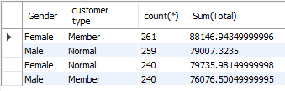
Customer Analysis
There are 501 females and 499 males. Females are generating more sales i.e. 167882.92500000002.
There are 501 customers are ‘members’ and 499 are ‘normal’. Members are generating more sales i.e. 164223.44400000002
There are more female customers who are members and generating more sales then Males.

Slide 25
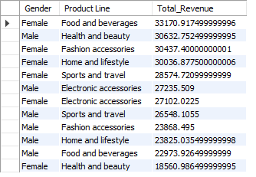
Customer Analysis
The Females are spending more on “Food And Beverages” followed by “Fashion And Accessories”, “Home and LifeStyle” and “Sports and Travel”.
The males are spending more on “Health and Beauty”.
The females are least spending on “Health and Beauty”.

Slide 26
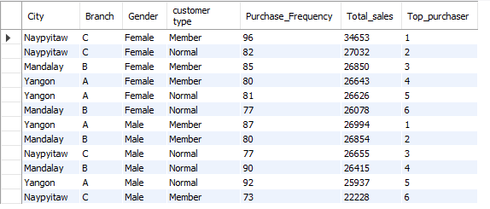
Customer Analysis WRT Branches
Except Naypyitaw, in all the cities members are making more sales then normal customers.

Slide 27
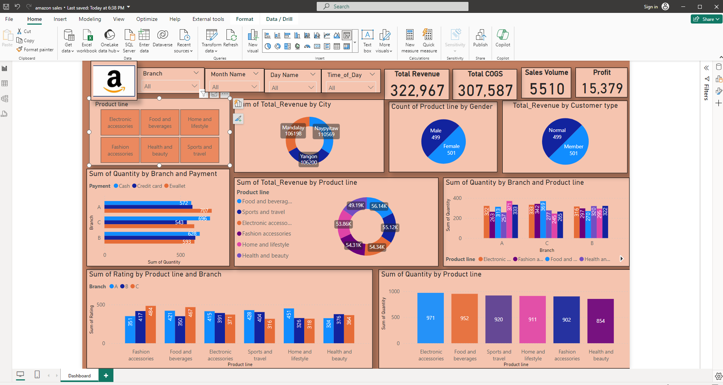

Slide 28
Recommendations:
To optimize sales performance, focus on promoting Fashion Accessories and Electronic Accessories through targeted marketing campaigns.
Introduce a "Home and Lifestyle Essentials" bundle offering curated products at a discounted price to encourage cross-selling and boost sales.
Launch a "Beauty Bonanza" campaign offering exclusive discounts on Health and Beauty products to attract more customers and increase sales in this category.
Additionally, explore cost optimization strategies in high-selling categories like Food and Beverages to increase profitability. For example: Negotiate bulk purchase deals with suppliers for high-selling products and reduce procurement costs and improve profitability.
Implement customer engagement initiatives such as loyalty programs to drive repeat purchases and enhance overall satisfaction.
Tailor marketing tactics to specific branch dynamics and leverage data analytics for informed decision-making.

Slide 29
Thank You

